Slide 1
The Writing Process
A Little Strategy Goes a Long Way
Part One – Prewriting

Slide 2

What is Process?

Slide 3
Why use a Process?
How do you undertake large projects?
Collect materials and information.
Plan and prepare; build framework.
Build.
Check and perform structural issues.
Check and perform aesthetic issues.
Sell to buyer.

Slide 4

Example – Building a House

Slide 5
Steps in the Writing Process
The steps should start in this particular order, but you may also redo them as many times as needed, whenever needed:
1. Prewriting
2. Organizing
3. Drafting
4. Revising
5. Editing and proofreading
6. Submit the finished work

Slide 6

WE all use Processes
All large projects require a sound process in order to be successful.
What kinds of processes do you use?
Travel
Meals
Anything else?
How?
-
-
-

Slide 7
The writing Process
Follow the cycle
First: Read the reading, then:
1. Prewriting
a. Freewriting
b. One other kind
6. Submit
2. Outlining
May need to revise at any stage
5. Editing
Check language, sentence, and other details
3. Drafting
Write from the latest outline
4. Revising
Check for meaning, evidence, and format

Slide 8
What is “The Writing Process?”
The answer is self evident: It is a process by which authors can approach writing.
How would you start a writing process?
The course will show you how to use a writing process to complete high-quality assignments.
See also https://owl.purdue.edu/owl/general_writing/the_writing_process/index.html

Slide 9
Step 1: Prewriting – finding a topic
Thinking about your topic and investigating its many possibilities may be the most important part.
First, consider your subject and read the source material carefully.
Do not just choose the obvious (the ‘C - Grade’ response); be inventive and unique.
Reread the assignment. Look for words in the clue that may direct you toward a direction.
Prewriting is also known as brainstorming.

Slide 10
Prewriting – cont’d.
These may refer to the ‘rhetorical modes’ (patterns of development) such as: narrate; describe; compare/contrast; define; relate a process; show cause and effect; argue for or against, and so on.
All writing will be in response to an idea in a reading.
Answer the question or respond correctly to the prompt.
Your purpose will be to express an idea (some insight) inspired by the reading.
Consider how the reading applies to international students.

Slide 11
Prewriting, cont’d
Make connections between the reading and “the real world”, or “the human condition”.
Do not summarize the story or simply discuss an idea without showing how the story illustrates your point.
Consider any supporting information, from the reading and from your own “prior knowledge” or insight as you prewrite. You will use both.
Note: Prewriting may seem like a nuisance, but students gratefully report that it has helped them improve all of their writing.

Slide 12
Prewriting:
Definition of pre
pre-
Word Origin
1.a prefix occurring originally in loanwords from Latin, where it meant “before” (preclude; prevent); applied freely as a prefix, with the meanings “prior to,” “in advance of,” “early,” “beforehand,” “before,” “in front of,” and with other figurative meanings (preschool; prewar; prepay; preoral; prefrontal).
https://www.merriam-webster.com/dictionary/pre-

Slide 13
Types of Prewriting
There are many types of prewriting to help you think about your topic.
You may choose a favourite or find different types suitable for different circumstances.
It is helpful to start with an open method, such as freewriting, first, and then also try a second type. This is required in ENGL 1313.
The computer is helpful, but also may be confining, at this stage.

Slide 14
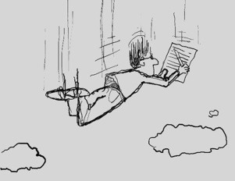
Prewriting – A. Freewriting
Freewriting is often given at the beginning of a unit, to ask students to explore their own ideas, or generate a unique topic.
Write freely, without stopping, for a given period of time (often 10-15 minutes).
Respond to an idea in the reading (do not retell the reading).
Do not stop for spelling, vocabulary, grammar, or other things that may hinder the flow of thought.

Slide 15
Freewriting – cont’d.
Hint: If you are writing but can’t find a word, quickly, just insert a line and come back to it, later.
Freewriting is a ‘warm up’. Do not worry if it wanders, seems incorrect, or goes off topic.
Freewriting is also useful to narrow a topic.
See: https://writingprocess.mit.edu/process/step-1-generate-ideas/instructions/freewriting

Slide 16
Prewriting – A. Freewriting – variation - Looping
Looping allows writers to continually narrow ideas from an original free thought to more refined ideas.
Start by freewriting.
Read the freewriting and look for an idea that strikes you. Circle it. [Draw a loop around it.]
Write by freewriting again, this time
about the circled idea.
Continue until you have sufficiently
narrowed the focus of the idea.
See:
https://patthomson.net/2018/08/20/a-writing-strategy%E2%80%8B-for-generating-ideas-looping/

Slide 17
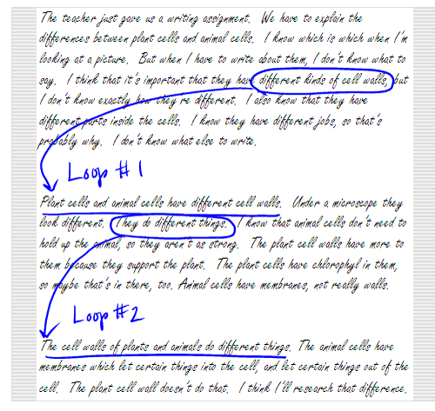
Looping - image
This is an example of how looping may look:

Slide 18
Prewriting – B: Questioning
Also known as ‘The Journalists’ Questions’ or ‘W5’.
You don’t know if you don’t have answers to:
Who?
What?
When?
Where? Why?
How? [sorry – 6]
Note: Also refer to the W5 answers while providing details in your written work. These details are vital to your audience.
See: https://www.powa.org/invent/journalists-questions.html

Slide 19

Journalists’ Questions
Always be curious!
https://www.knowledgecompass.org/5w-questions.html

Slide 20
Prewriting – C: Listing
Lists are easy ways to quickly write down ideas.
How do you use lists everyday?
For Prewriting
Write quickly
A vertical list
Only key words
Do not stop to correct or organize
Ideas flow freely.

Slide 21
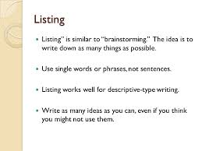
Prewriting - Listing

Slide 22
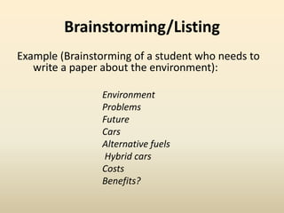
Listing, Example

Slide 23
Prewriting – D: Clustering
Also known as diagramming (and sometimes brainstorming).
Visual
Many variations
Computer versions can be highly organized, but also restricting.
See: https://sunyempire.edu/online-writing-support/resources/academic-writing/process/prewriting-developing-ideas/clustering/mapping/
?
?
?
A
B

Slide 24
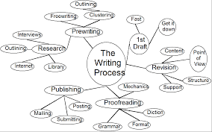
Clustering using the Writing Process

Slide 25
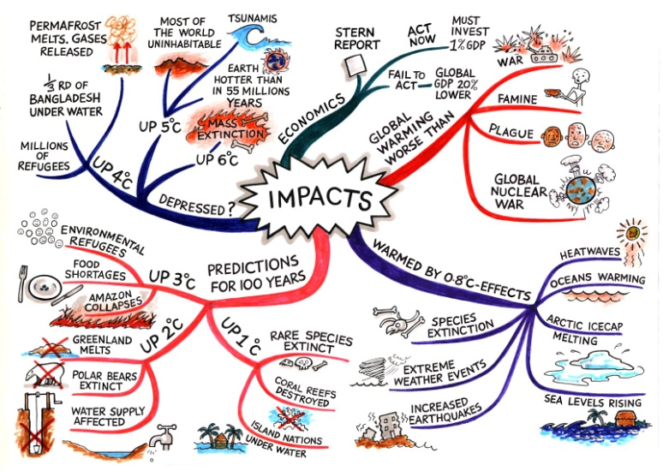
Prewriting – E: Mind Mapping.
Hand-drawn versions can allow for creativity but can become crowded.
See https://www.mindmapping.com/mind-mapping-in-education
Search for “mind map” in Google images. You’ll be amazed! Now that’s how to open up your mind!

Slide 26
Prewriting – E. Cubing
Cubing is a technique of prewriting especially good for topics that require deep analysis.
Imagine your general subject as a cube.
Imagine each plane of that cube as a different way of approaching the subject.
Cubing is also excellent for tackling difficult concepts or to use when arguing for a point of view.

Slide 27

Cubing – cont’d.
Use cubing to
A) Discover new ideas, or
B) Analyze an idea
Technique – Dedicate an approach to each plane:
Describe it
Compare it
Apply it
Associate it
Analyze it, and
Argue for or against it

Slide 28

Summary - Prewriting
Do use it!
Use at least two methods.
Why?
“Despair is most often the offspring of ill-preparedness” – Don Williams Jr.
Include prewriting when submitting work. It will not be marked, but you will gain credit for it.

Slide 29
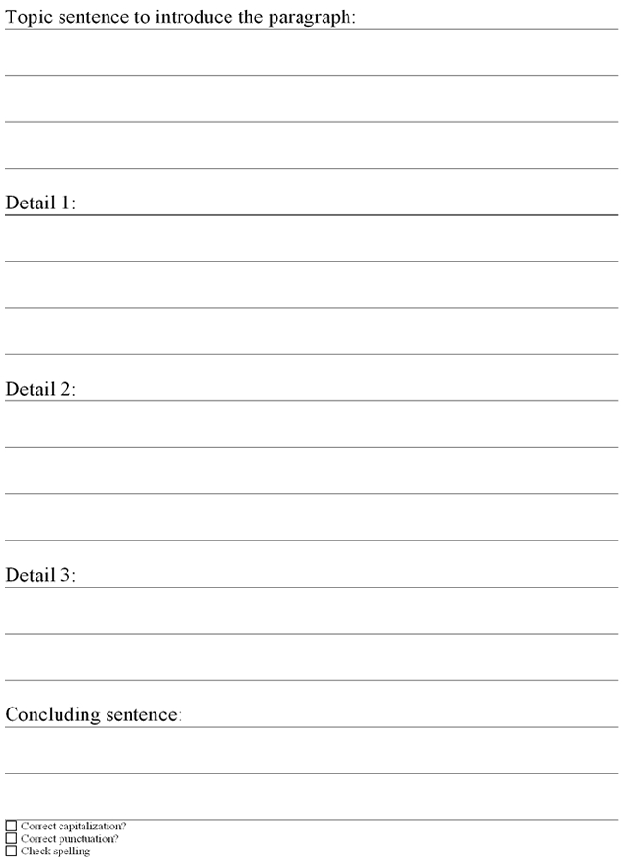
The Next Step…
Create a working outline

Slide 30
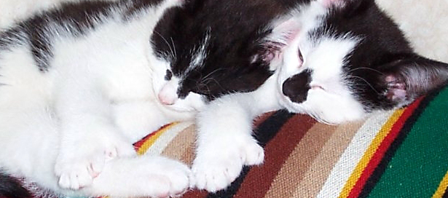

Now, on to step two – Organizing or Outlining
After collecting, sorting, and thinking about all your ideas, the next step is to organize them into a proper outline.
Enjoy!

